Slide 1
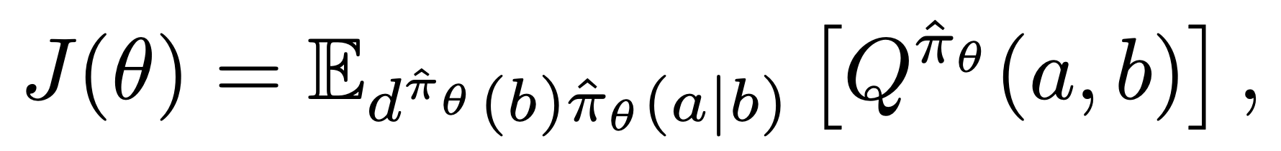
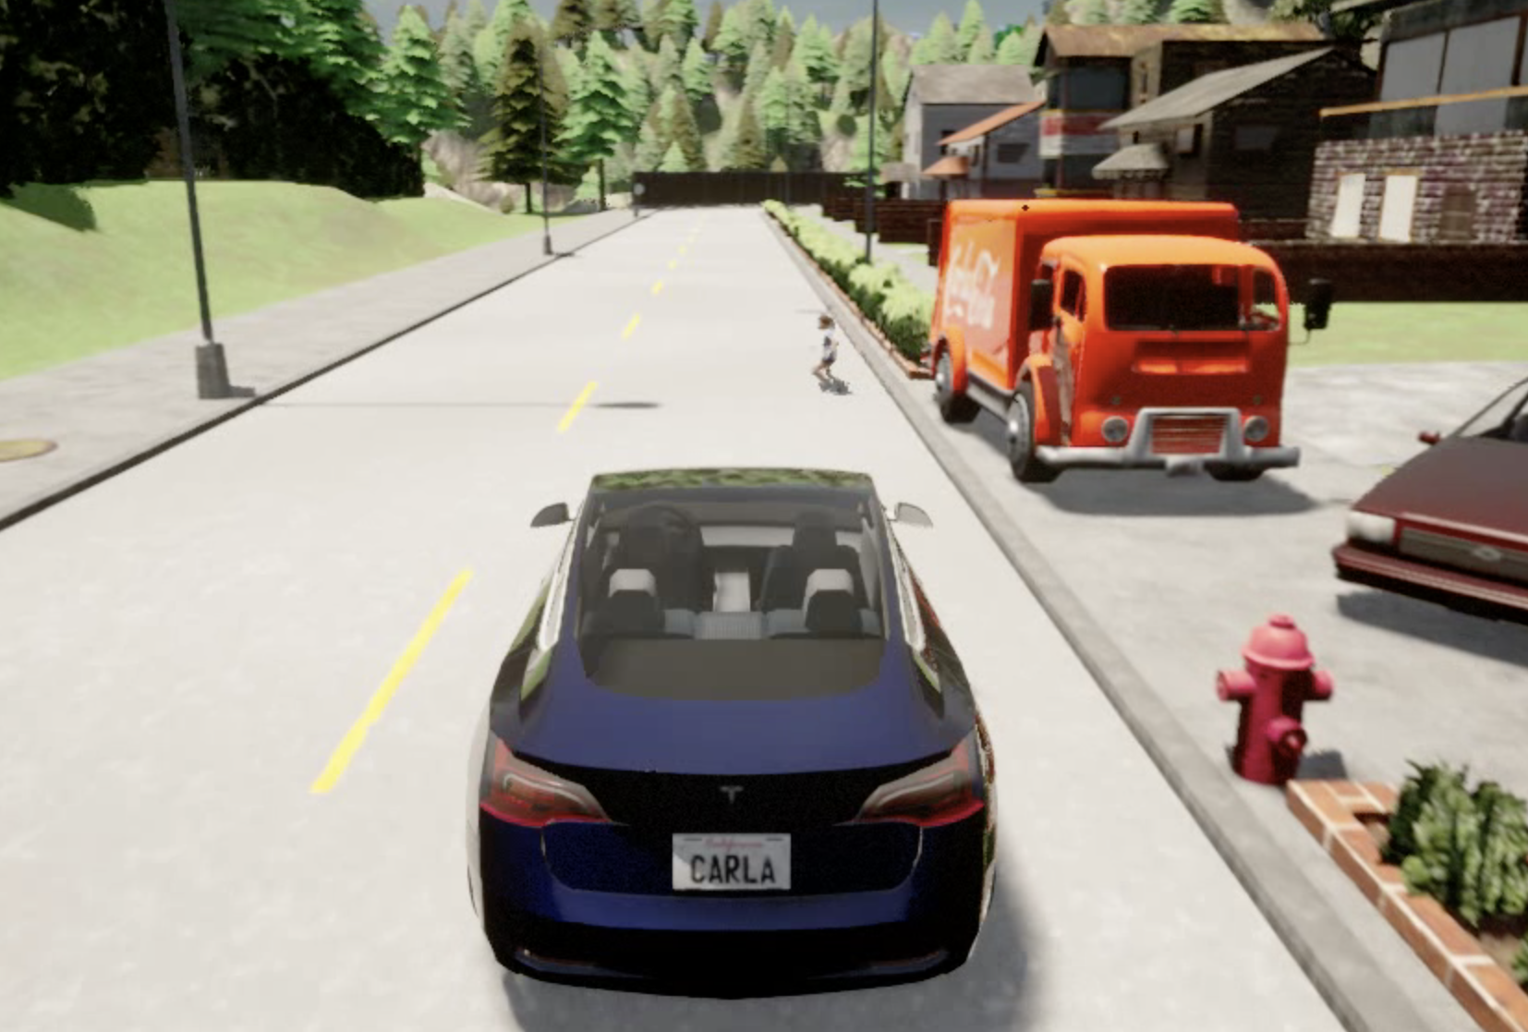
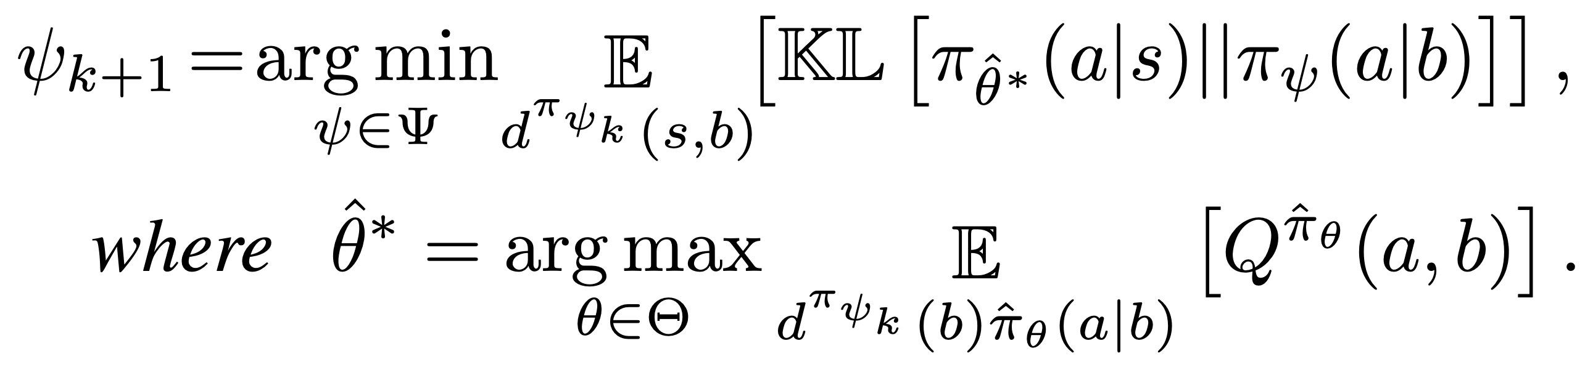
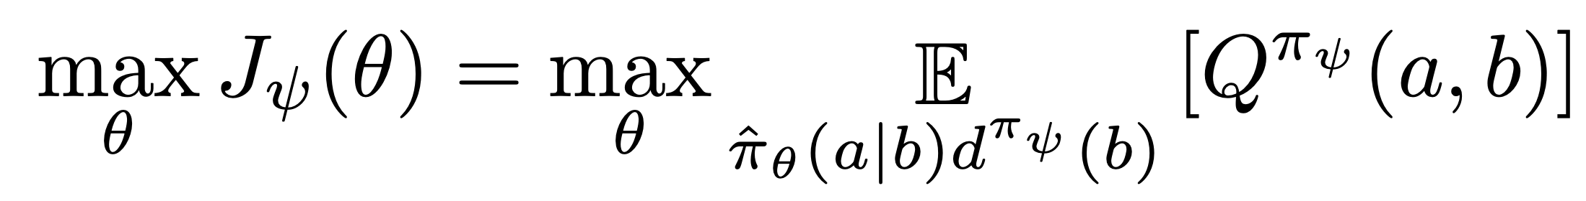
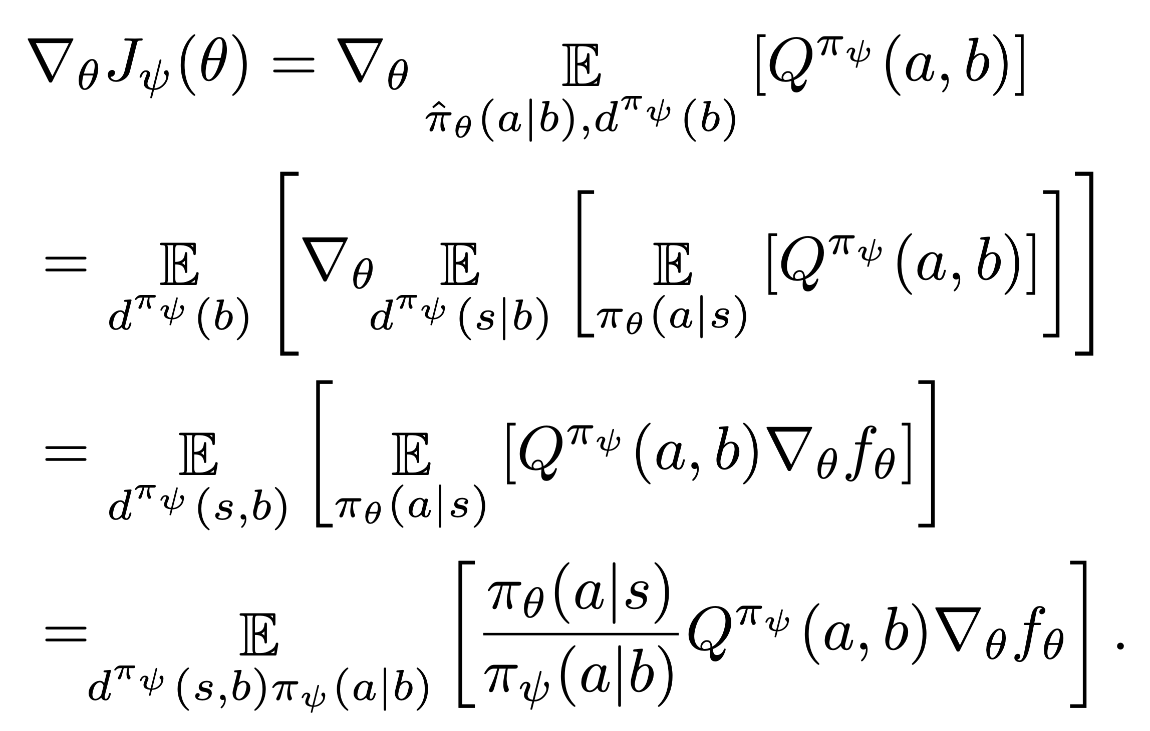
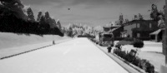
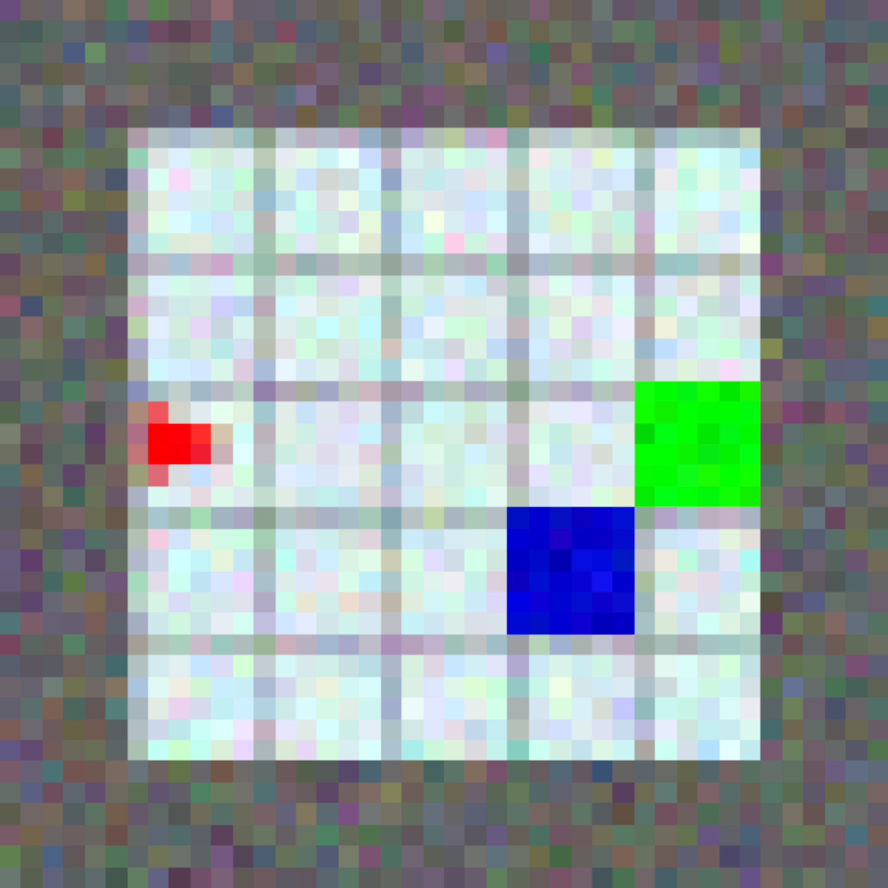
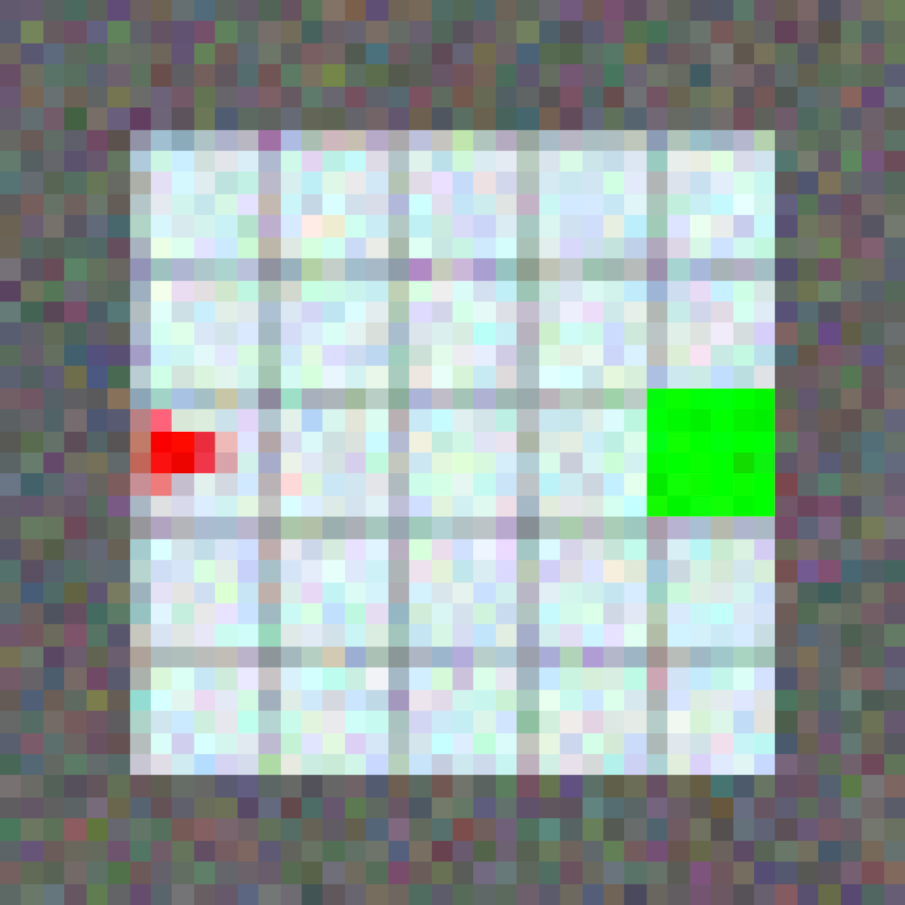
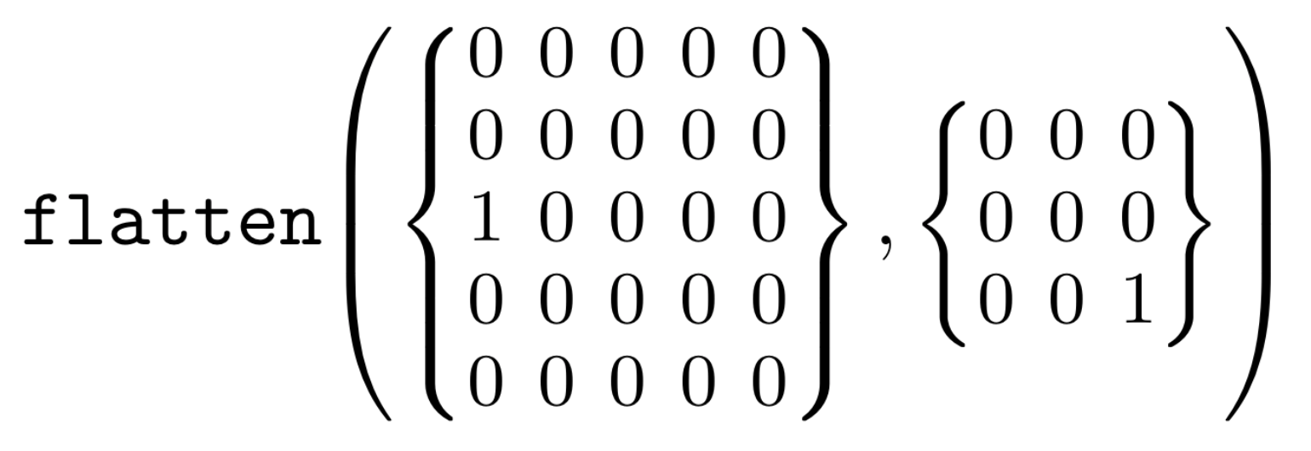
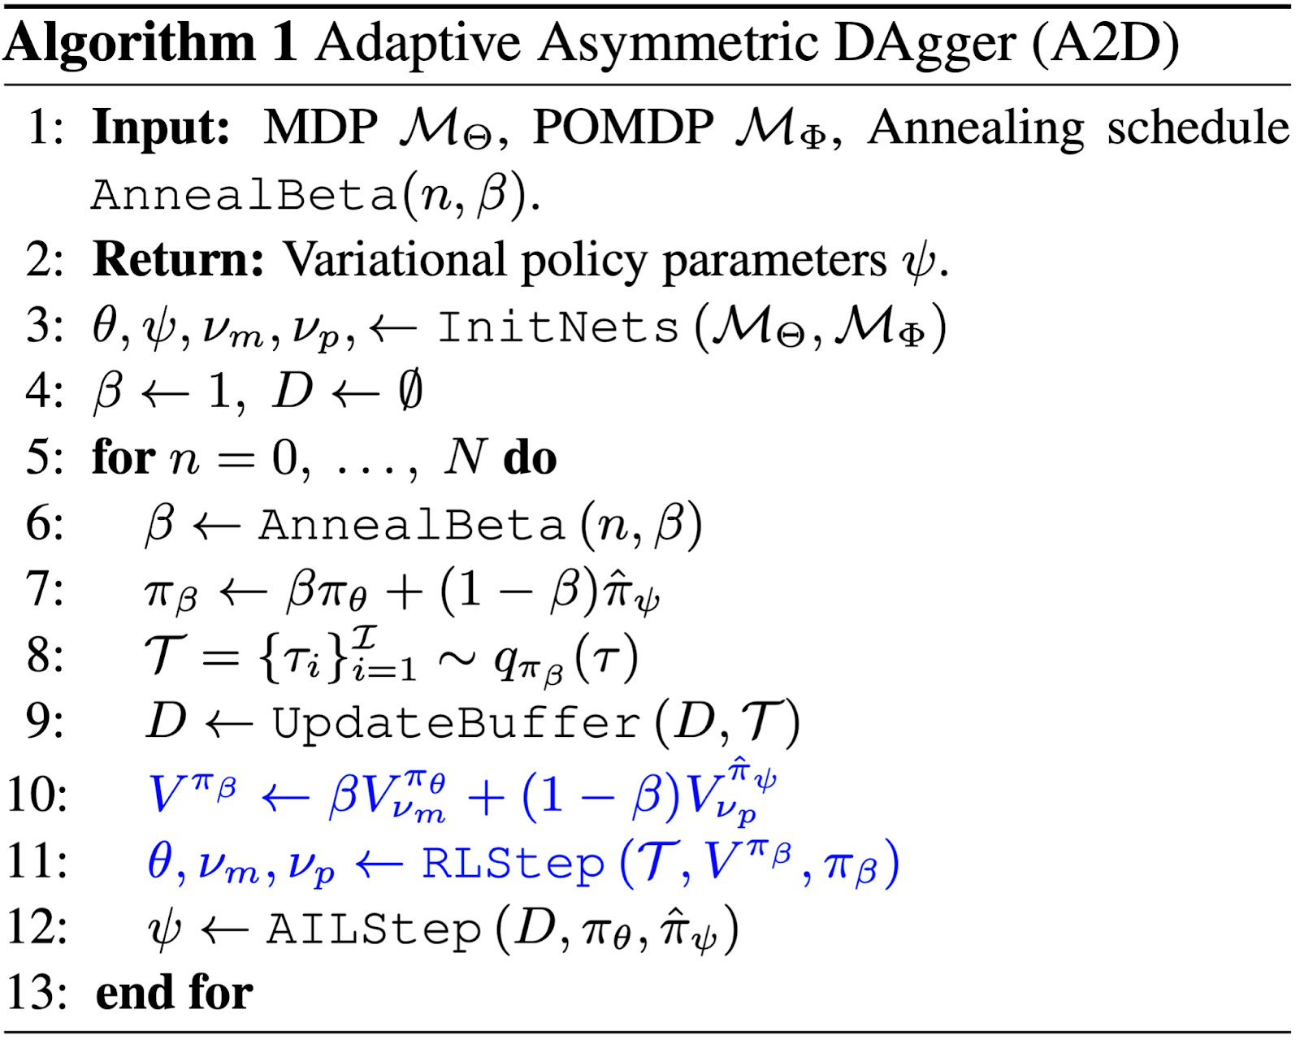
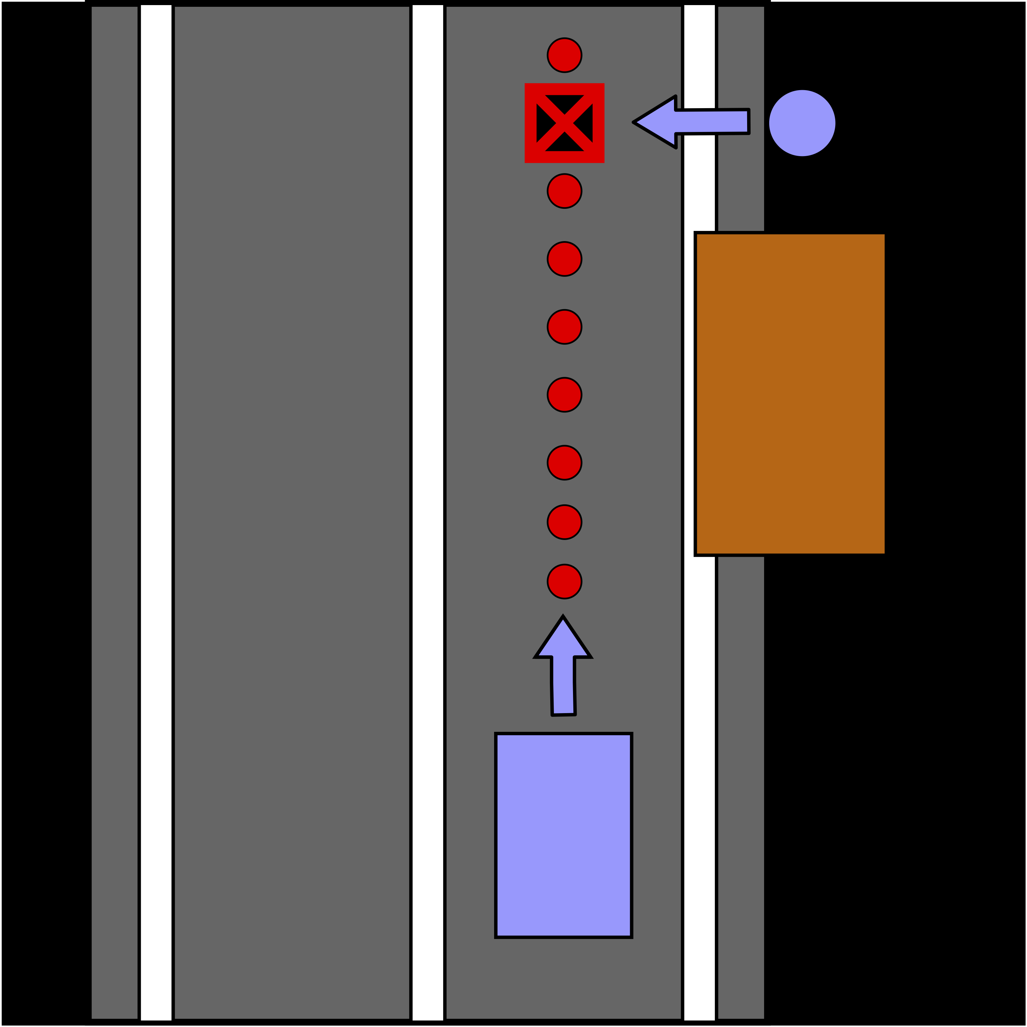
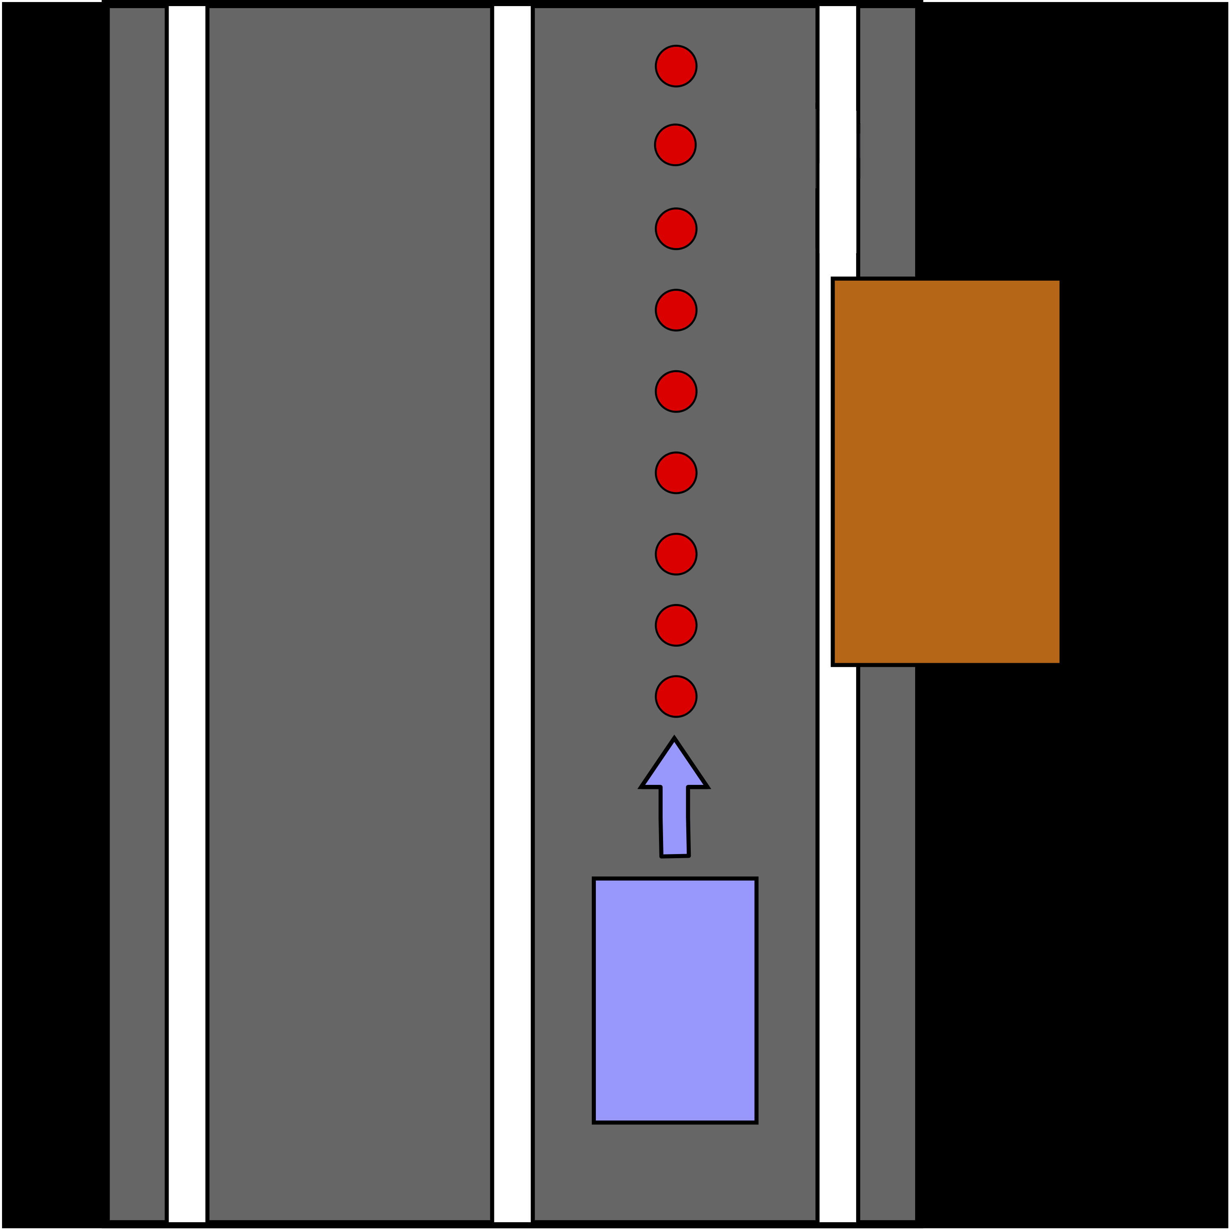
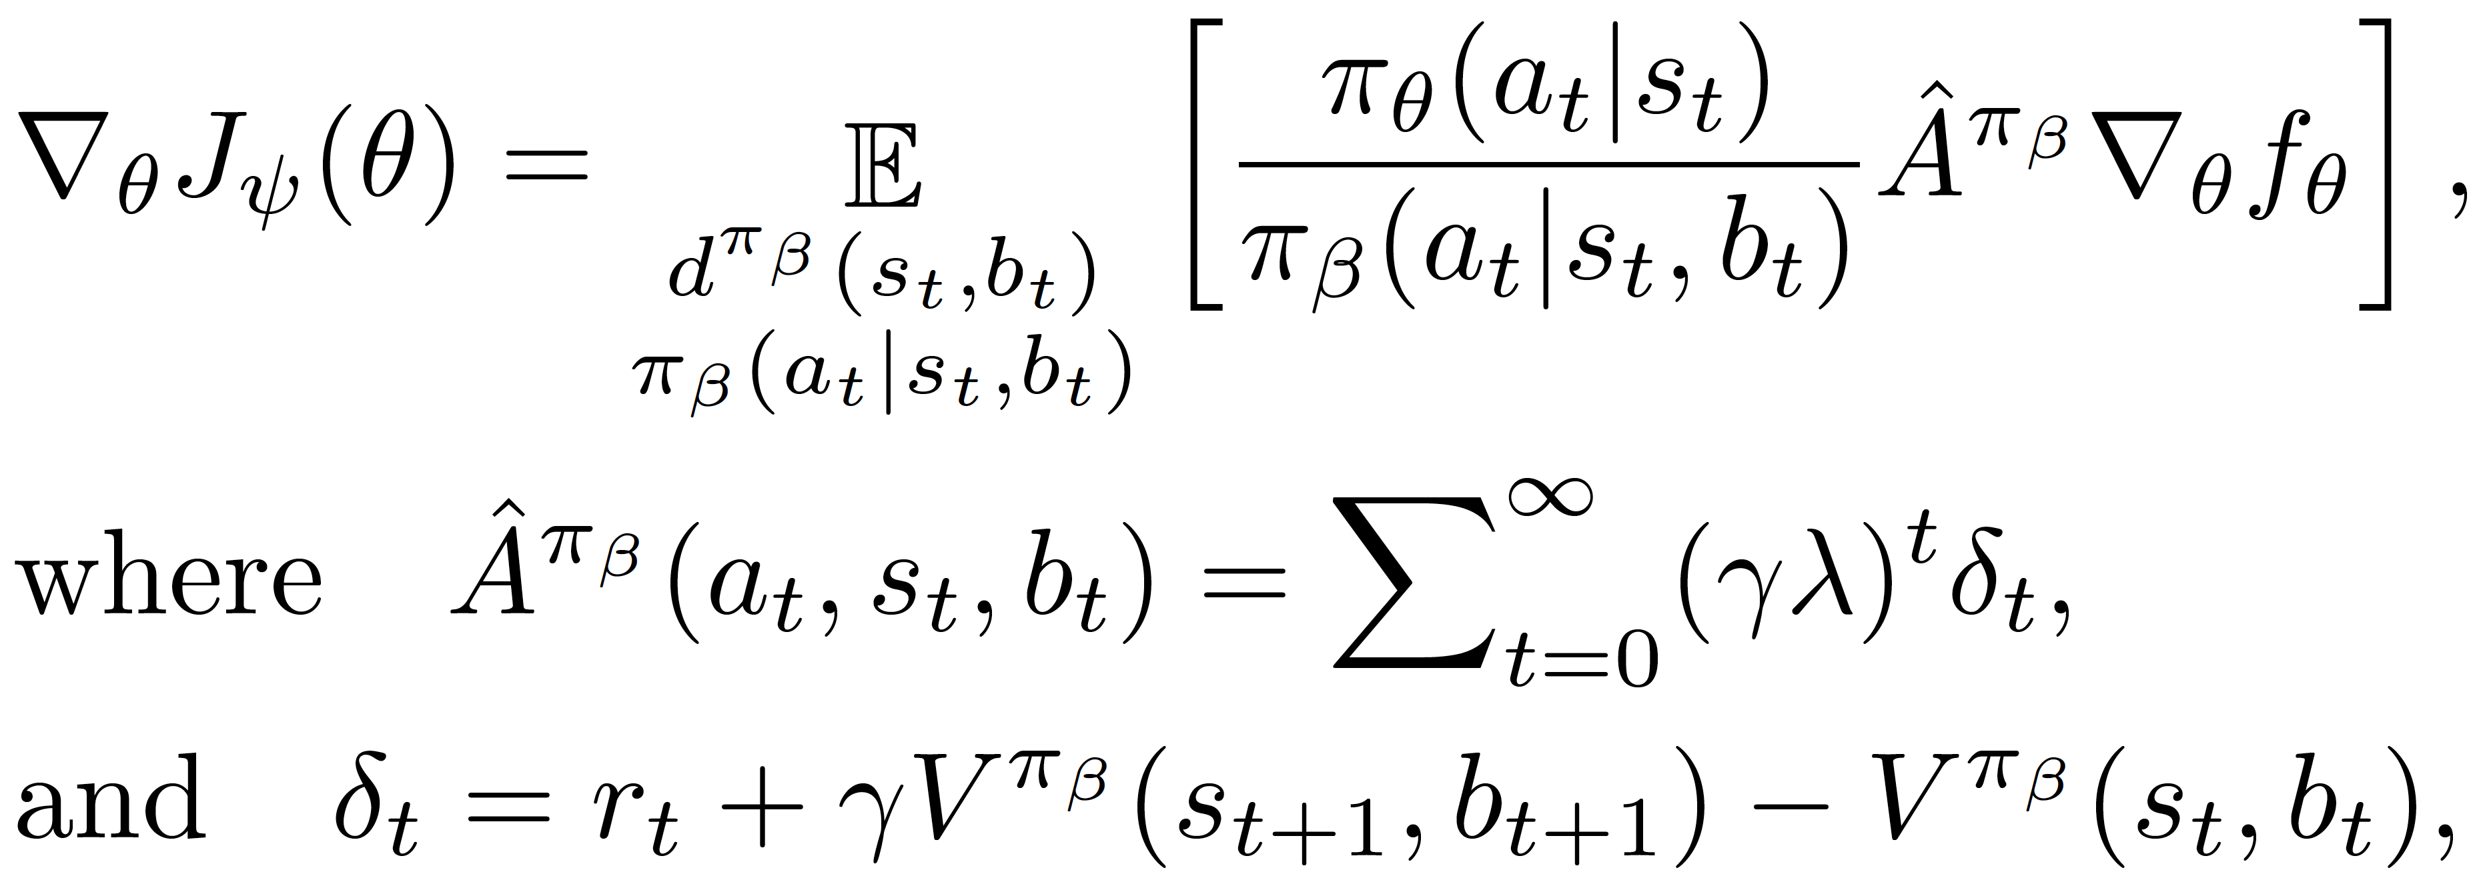
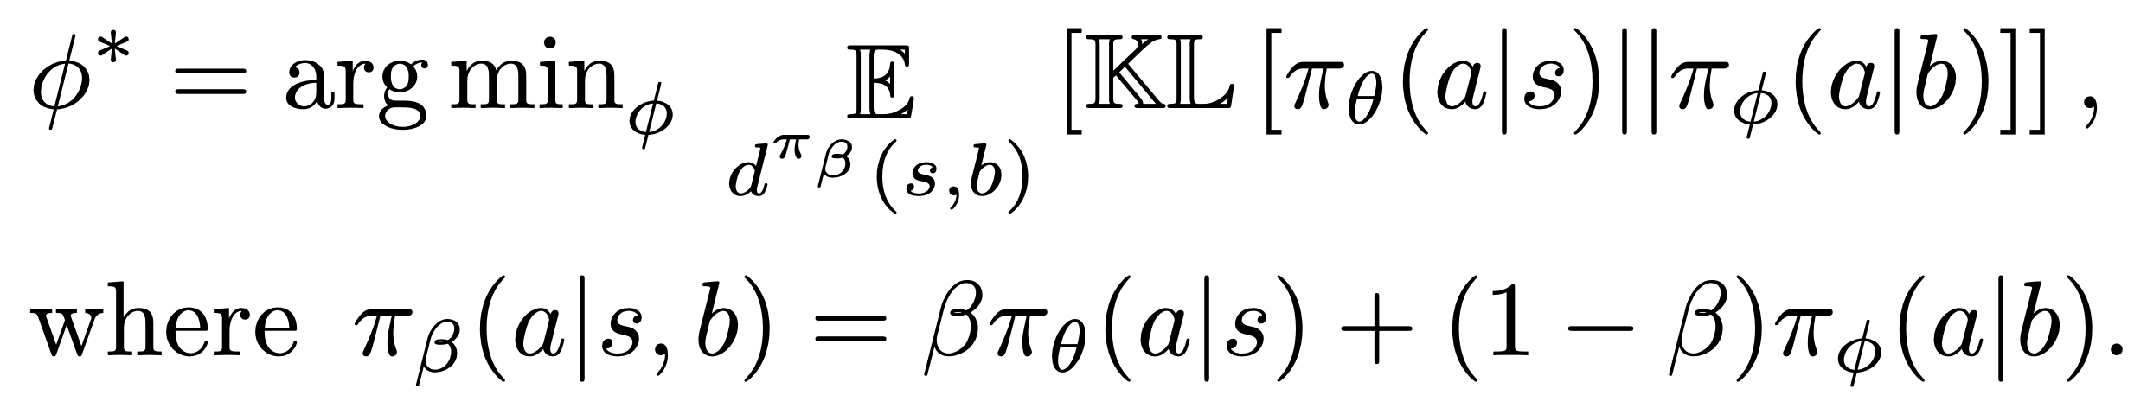
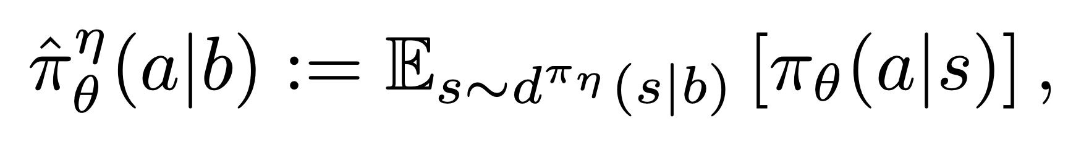
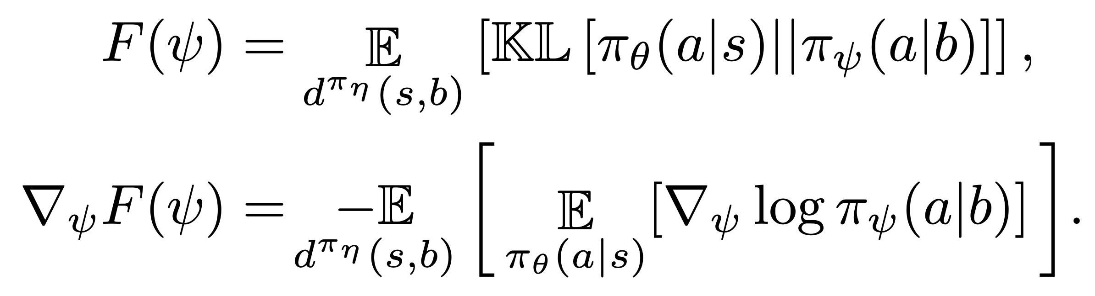
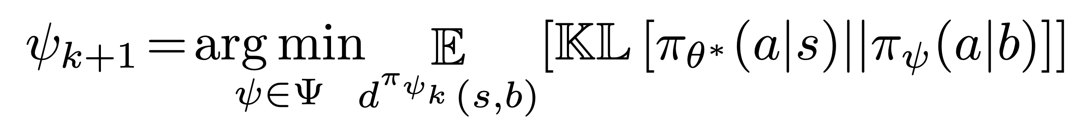

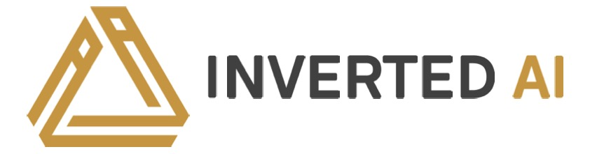
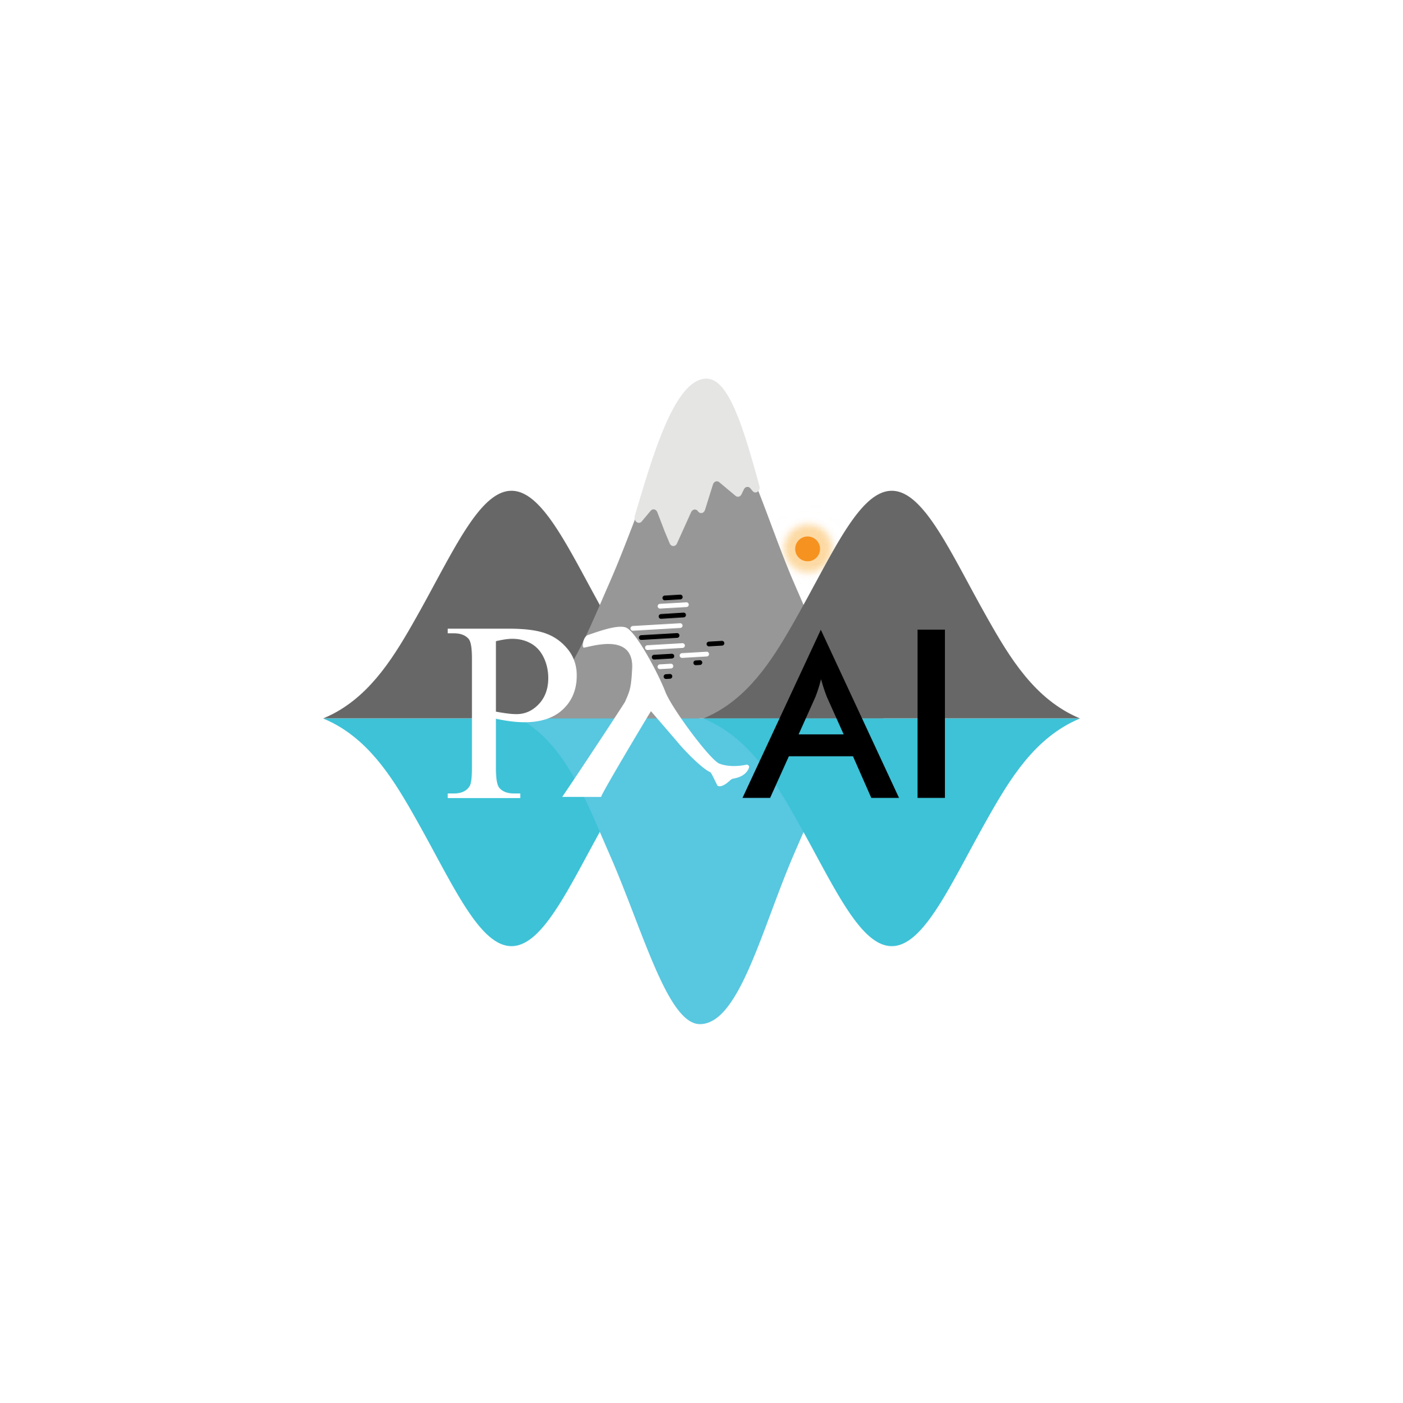
Robust Asymmetric Learning in POMDPs
Andrew Warrington*, J. Wilder Lavington*, Adam Ścibior, Mark Schmidt & Frank Wood
*Denotes Equal Contribution, Paper ID 9327, email: andrew.Warrington@keble.ox.ac.uk
TL;DR
Imitation learning and asymmetric information can expedite RL.
However, using both can lead to catastrophic policies.
We introduce Adaptive Asymmetric DAgger (A2D).
A2D updates the expert to maximize the reward of the trainee.
Exact A2D Update
Define RL objective in terms of implicit policy:
Theorem 3: Can define convergent iteration (under exact updates):
Maximize over rollouts instead under current variational policy:
Autonomous Vehicles
Occluded hazard scenario, based on CARLA Challenge.
Figure 1: Schematic comparing DAgger [ross2011a] and A2D. The additional A2D feedback loop is highlighted in blue.
Asymmetric Environments
A2D Algorithm
Builds directly on DAgger + RL.
Mix between expert and trainee
Use Monte Carlo + GAE update:
Figure 2: Illustration of the asymmetric grid world environment, Frozen Lake. Left: The full environment, showing the weak patch of ice. Center: The high-dimensional, partial image-based observation available at runtime. Right: The low-dimensional, complete asymmetric state representation available at train time.
Asymmetric Imitation Learning
Learn agent (referred to as a trainee) by imitating expert.
Minimize KL-divergence between trainee and expert:
Definition 1 & Theorem 1: Solution to minimization is referred to as the implicit policy: (also discussed by Weihs et al. [wei2020a])
Learn variational approximation:
Can define convergent iteration:
Definition 2 & Theorem 2: AIL is only guaranteed to recover the optimal trainee if the MDP and POMDP are identifiable:
Algorithm 1: A2D algorithm. Steps in blue highlight additional steps beyond Dagger [ross2011a].
Figure 4: Top: Scenario illustrations. The car must drive to the end of the road to earn reward. A child darts from behind the parked vehicle with fixed probability and must be avoided. Middle: Monocular camera view available to the trainee. Bottom: Schematic of the scenario with and without the child, and the path of the vehicle.
Figure 5: Top: A2D converges to a policy with a higher reward more quickly and reliably than direct RL. AIL converges almost immediately but to a bad policy. Bottom: A2D learns a policy that avoids the child with near certainty, whereas AIL cannot learn this behavior.
Gridworld
Help
Source Code & Additional Materials
Source code: www.github.com/plai-group/a2d
Also includes links and materials for talk, poster & paper.
Paper: www.arxiv.org/pdf/2012.15566.pdf
Key References
[pin2017a] Pinto, L., Andrychowicz, M., Welinder, P., Zaremba, W., & Abbeel, P. (2017). Asymmetric actor critic for image-based robot learning. Robotics: Science and Systems XIV.
[ros2011a] Ross, S., Gordon, G., & Bagnell, D. (2011). A reduction of imitation learning and structured prediction to no-regret online learning. Proceedings of the Fourteenth International Conference on Artificial Intelligence and Statistics (pp. 627-635). JMLR Workshop and Conference Proceedings.
[sch2015a] Schulman, J., Levine, S., Abbeel, P., Jordan, M., & Moritz, P. (2015). Trust region policy optimization. International conference on machine learning (pp. 1889-1897). PMLR.
[wei2020a] Weihs, L., Jain, U., Salvador, J., Lazebnik, S., Kembhavi, A., & Schwing, A. (2020). Bridging the imitation gap by adaptive insubordination. arXiv preprint arXiv:2007.12173.
Figure 3.a: Top: Frozen Lake. Bottom: Tiger Door. Left: Reward plots for various approaches. We see that A2D converges to the optimal POMDP policy, in commensurate time for both representations. AIL converges quickly but to a to a bad policy. Direct RL converges slowly. Right: Divergence between expert and trainee policies during training. AIL is unable to reduce the divergence due to the inherent unidenfiability, whereas A2D converges to a low divergence.

